Slide 1
ArchEnsemble: Architectural Approach for More Efficient Ensemble
STAT433 Final Project
Hyogon Ryu
Department of Cyber Defense, Korea University
2019330023

Slide 2
Contents
Why this research?
Related Works
Approach
Experiments
Conclusion

Slide 3

Why this research?
Ensemble in Deep Neural Network
Model Ensemble’s Pros
Higher Accuracy & Robustness
Model Ensemble’s Cons
Standard Ensemble Method needs the multiple computation cost.
Especially Deep Neural Network, computation cost is the important issue.
Model 1
Panda
Model 2
Model 3

Slide 4
Why this research?
Ensemble in Deep Neural Network
Model Ensemble’s Pros
Higher Accuracy & Robustness
Model Ensemble’s Cons
Standard Ensemble Method needs the multiple computation cost. (training time / inference time)
Especially Deep Neural Network, computation cost is the important issue.
Model 1
?
Panda
Model 2
Model 3

Slide 5
Why this research?
Ensemble in Deep Neural Network
Model Ensemble’s Pros
Higher Accuracy & Robustness
Model Ensemble’s Cons
Standard Ensemble Method needs the multiple computation cost. (training time / inference time)
Especially Deep Neural Network, computation cost is the important issue.
?
Panda
Model

Slide 6
Related Works
papers
Batchensemble: an alternative approach to efficient ensemble and lifelong learning
Learning Loss for Test-Time Augmentation

Slide 7
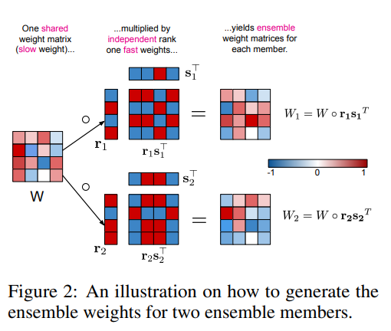
Related Works
Batchensemble: an alternative approach to efficient ensemble and lifelong learning
?

Slide 8
Related Works
Batchensemble: an alternative approach to efficient ensemble and lifelong learning
Model 1
Panda
Model 2
Model 3
Model

Slide 9
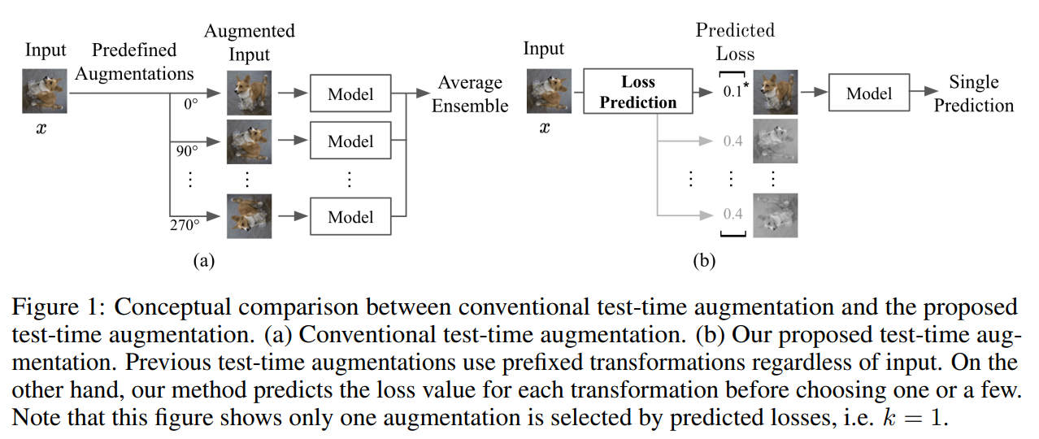
Related Works
Learning Loss for Test-Time Augmentation

Slide 10
Approach
Main idea
Is there a model architecture that makes an ensemble-like effect?
Panda
Model

Slide 11
Approach
Main idea
Is there a model architecture that makes an ensemble-like effect?
CNN
SimpleCNN
ResNet20 / 32
prediction
num_class
Feature map
num_class * ensemble
ArchEnsemble: Architecture

Slide 12
Approach
trial and error
Is there a model architecture that makes an ensemble-like effect?
Prediction 1
CNN
SimpleCNN
ResNet20 / 32
Prediction 2
Prediction 2
Feature map

Slide 13
Approach
trial and error
Is there a model architecture that makes an ensemble-like effect?
Prediction 1
CNN
SimpleCNN
ResNet20 / 32
Prediction 2
Prediction 2
Feature map

Slide 14
Approach
Main idea
Is there a model architecture that makes an ensemble-like effect?
CNN
SimpleCNN
ResNet20 / 32
prediction
num_class
Feature map
num_class * ensemble
ArchEnsemble: Architecture

Slide 15
Approach
Main idea
Is there a model architecture that makes an ensemble-like effect?
1
CNN
SimpleCNN
ResNet20 / 32
prediction
2
num_class
Feature map
3
num_class * ensemble
ArchEnsemble: Architecture

Slide 16


Approach
How to Train?
1
CNN
SimpleCNN
ResNet20 / 32
CrossEntropyLoss
2
Feature map
3
num_class * ensemble
ArchEnsemble: How to Train?

Slide 17
Experiments
Setting
Since this is not the application project,
I didn’t work hard to optimize the hyperparameter
Exp. on Colab.
Dataset: CIFAR10, CIFAR100
Backbone CNN Model: SimpleCNN(2 conv-layer), ResNet20, ResNet32
ensemble : 1, 2, 4
Optimizer : Adam
Learning Rate Schedular: StepLR
Learning rate: 1.0
Learning rate step gamma : 0.7
batch_size 10

Slide 18
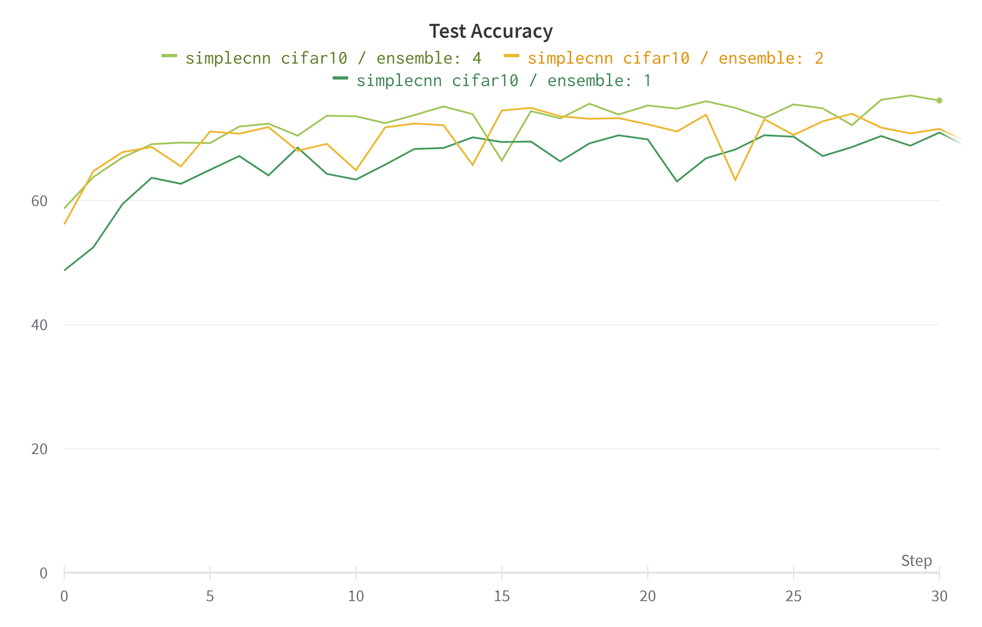
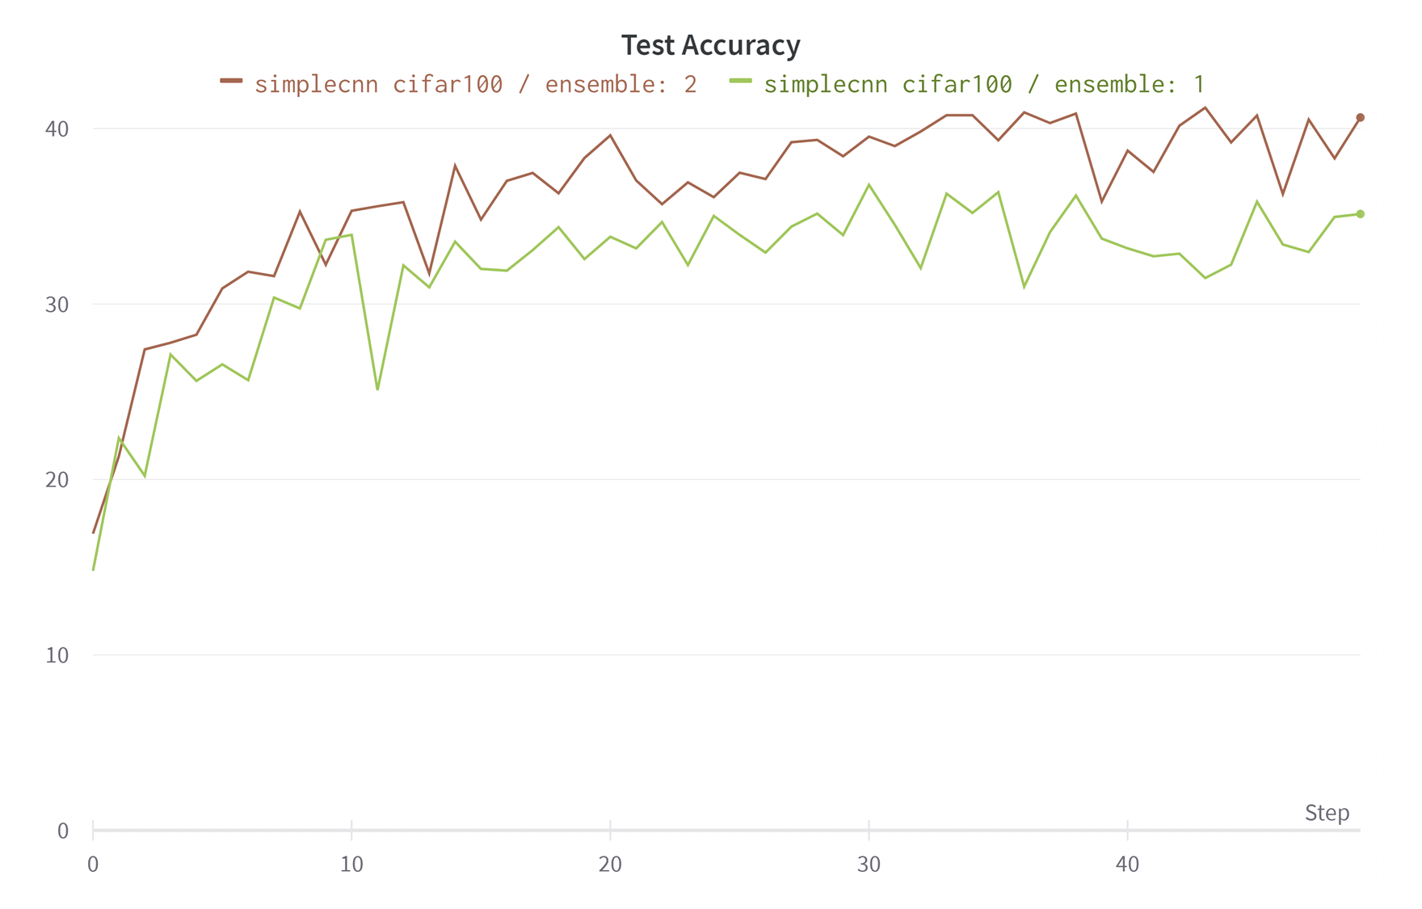
Experiments
Result
SimpleCNN
Fig1. CIFAR-10/SimpleCNN test accuracy(ensemble: 1,2,4)
Fig2. CIFAR-100/SimpleCNN test accuracy(ensemble: 1,2)

Slide 19
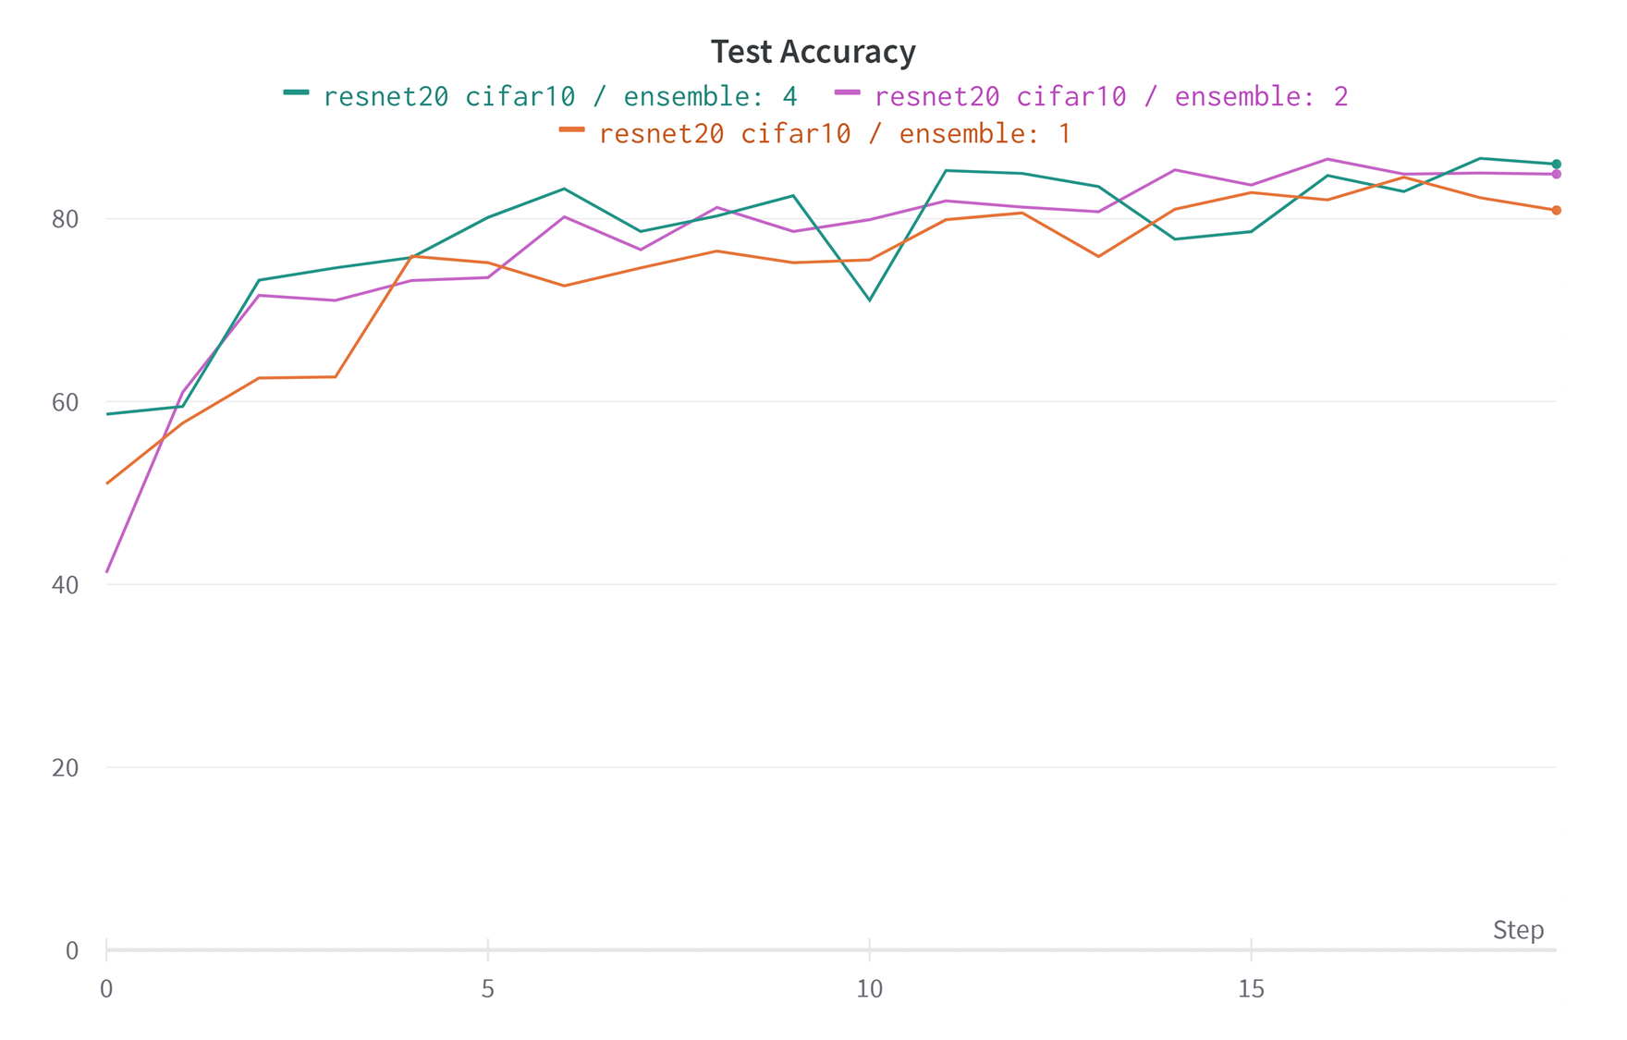
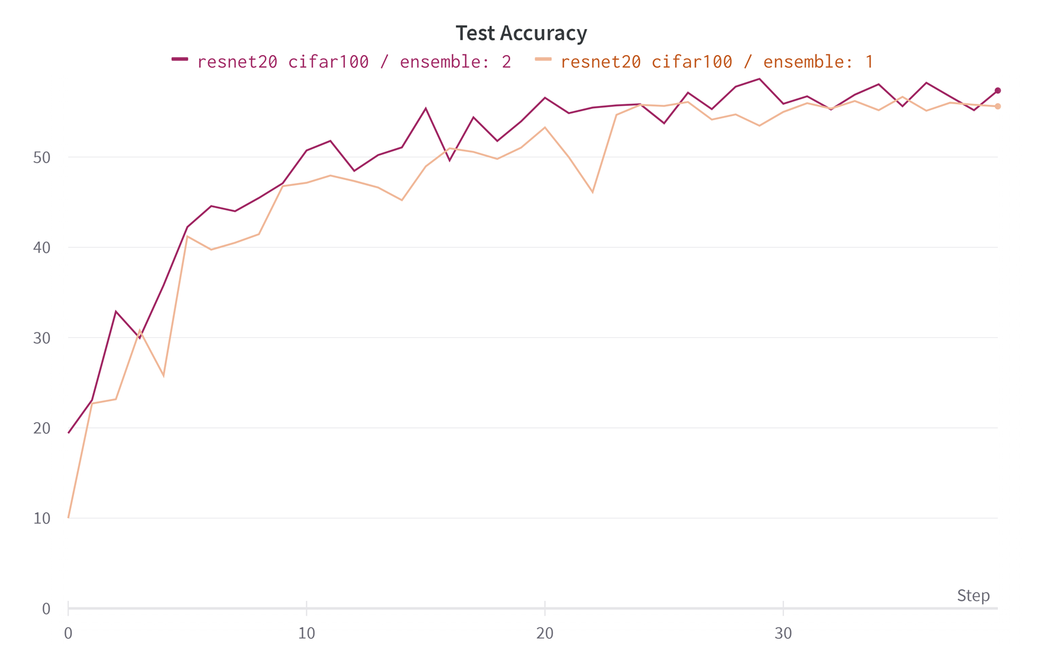
Experiments
Result
ResNet20
Fig3. CIFAR-10/ResNet20 test accuracy(ensemble: 1,2,4)
Fig4. CIFAR-100/ResNet20 test accuracy(ensemble: 1,2)

Slide 20
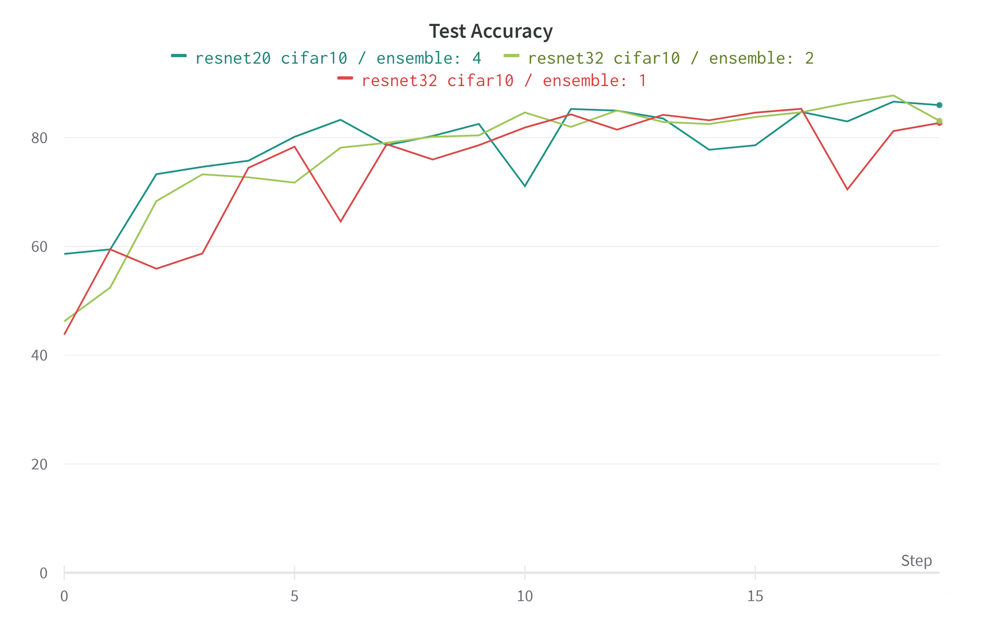
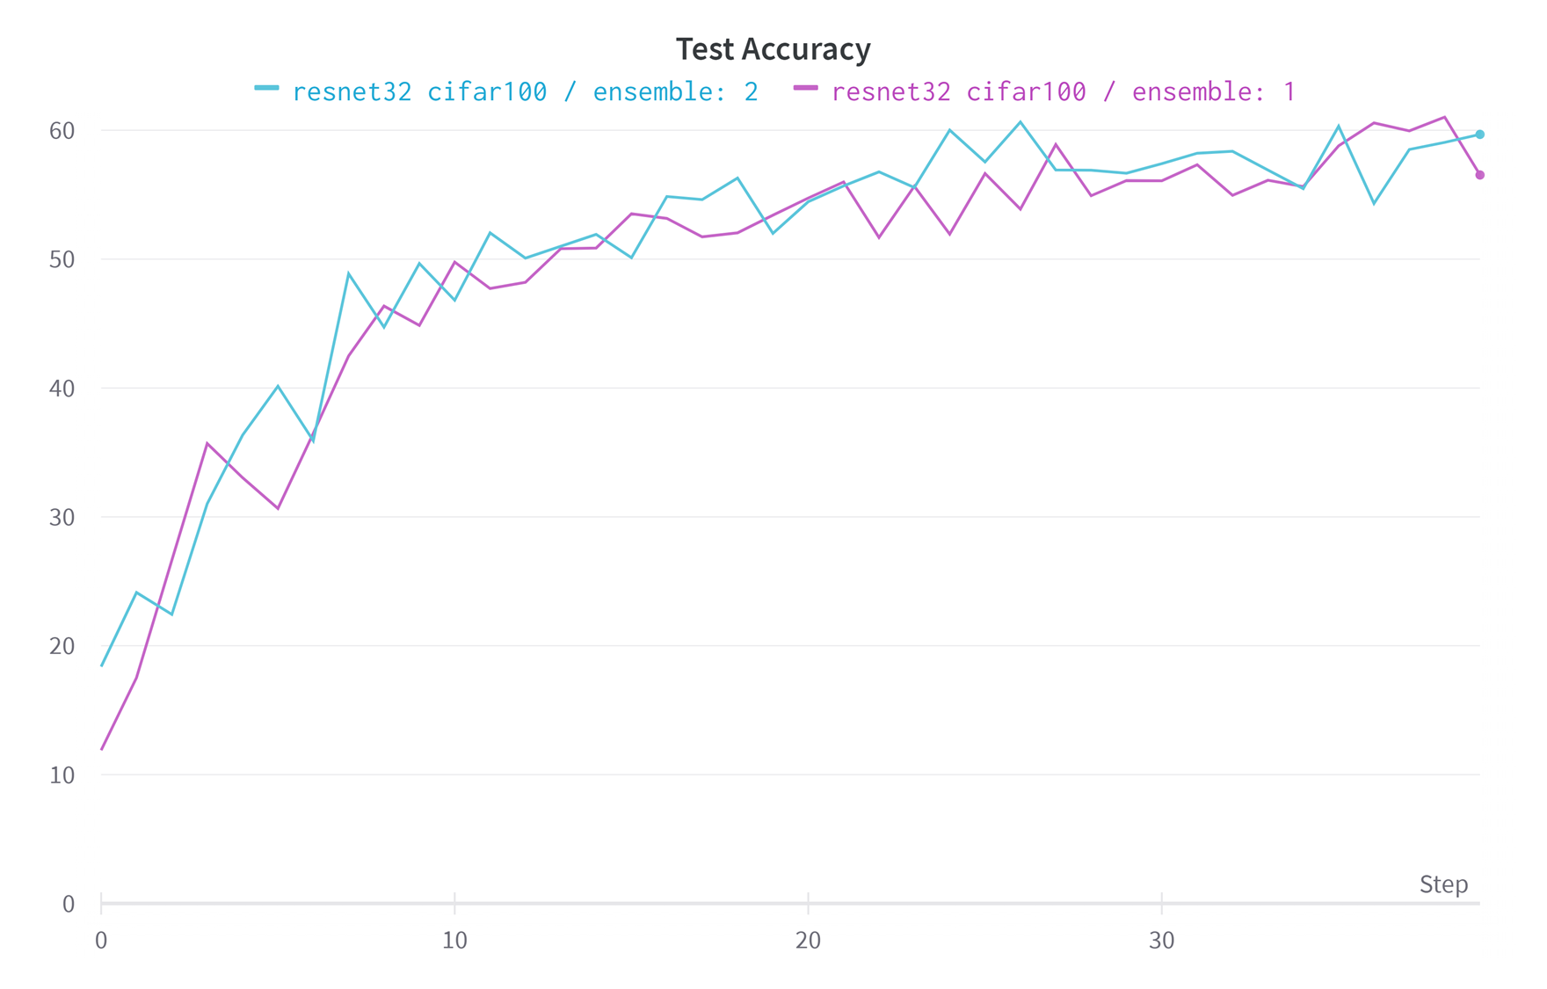
Experiments
Result
ResNet32
Fig5. CIFAR-10/ResNet32 test accuracy(ensemble: 1,2,4)
Fig6. CIFAR-100/ResNet32 test accuracy(ensemble: 1,2)

Slide 21
Experiments
Result
Model | # of Ensemble | CIFAR-10 | CIFAR-100
SimpleCNN | 1 | 68.63 | 35.13
 | 2 | 74.35 | 40.63
 | 4 | 76.15
ResNet20 | 1 | 80.92 | 52.03
 | 2 | 84.88 | 56.46
 | 4 | 85.97
ResNet32 | 1 | 82.69 | 56.53
 | 2 | 83.07 | 59.68
 | 4 | 87.02
Tables 1. top-1 Accuracy of each model. Best results are Highlighted

Slide 22
Conclusion
conclusion
I propose the ArchEnsemble, a novel architectural efficient ensemble method.
It’s very simple and easy to implement.
In addition, this method can be applied to all kind of CNNs.
This method doesn’t have to train the other model. It’s greatly benefited in computation cost.
By applying this method, model accuracy can be significantly increased.
It worked well for a simple architecture, but the more complex the architecture, the worse the performance. This part needs analysis.

Slide 23
reference
Wen, Y., Tran, D., & Ba, J. (2020). Batchensemble: an alternative approach to efficient ensemble and lifelong learning. arXiv preprint arXiv:2002.06715.
Kim, I., Kim, Y., & Kim, S. (2020). Learning loss for test-time augmentation. Advances in Neural Information Processing Systems, 33, 4163-4174.
Soflaei, M., Guo, H., Al-Bashabsheh, A., Mao, Y., & Zhang, R. (2020, April). Aggregated learning: A vector-quantization approach to learning neural network classifiers. In Proceedings of the AAAI Conference on Artificial Intelligence (Vol. 34, No. 04, pp. 5810-5817).
Krizhevsky, A., & Hinton, G. (2009). Learning multiple layers of features from tiny images.
https://github.com/akamaster/pytorch_resnet_cifar10

